Slide 1
Halton Hills Youth Centers Project-
Husni and Zaynab
H
The Process and Development of the New Youth Center Programs

Slide 2
The Beginning of the Project
H
We made contact with Jen Ancona, the community partner for the Halton Hills Recreation Department
We learned what the department wanted from the project
Threw around ideas in a meeting
Formulated a large document to group our thoughts and plans
Officially decided what we wanted to do

Slide 3
What We Wanted to Do
H
What was wanted was a project that would expand on awareness of Youth Centers, emphasized drop in opportunities, and empowered youth voices in the community
So something easily accessible, targeted at youth from 12-24, and that would be oriented around giving youth a voice in Youth Center activities
We went back and forth between the drop in/accessibility aspect, in favor of something that would be more long term and involved
Then we came to a decision

Slide 4
Program 1-Youth Center Feedback Meetings
Z
Regular meetings to get feedback from the community
Held online, drop-in on Instagram live
Discussion based on Youth Center feedback
Targeted at youth 12-24, prime demographic for youth centers
Gives volunteer hours for meaningful participation
Run by Youth Center Staff or Peer Leadership Members
Notes:
Zaynab

Slide 5
Program 2-Youth Center Peer Leadership
Z
Monthly meetings, one in Georgetown Youth Center, another in Acton Youth Center
Recurring group of youth who have made a commitment
While other program focused on feedback, peer leadership focused on taking an active role in the Youth Center programming, much like what we have done
Will lead the Feedback meetings
Volunteer hours given
Notes:
Zaynab

Slide 6
Advertising and Data Collection
Z
We needed to get the word out and gauge community interest in the programs. So we created a survey to collect information, and shared it around in a few ways.
Posters placed in Youth Centers
Instagram Posts and Stories
Announcements made to Schools with the relevant demographic
Notes:
Zaynab

Slide 7
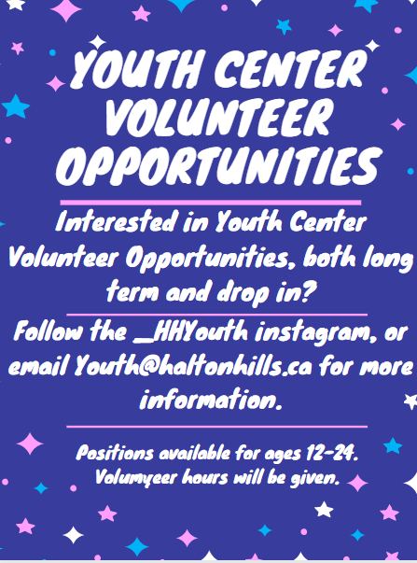
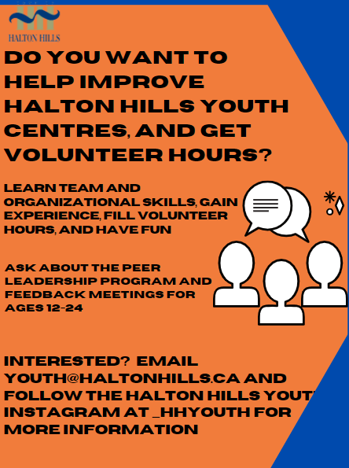
Posters
H
We created a few posters to share around, with basic information and details of where you can learn more. They were shared at Youth Centers, on social media, and with digital announcements with schools

Slide 8
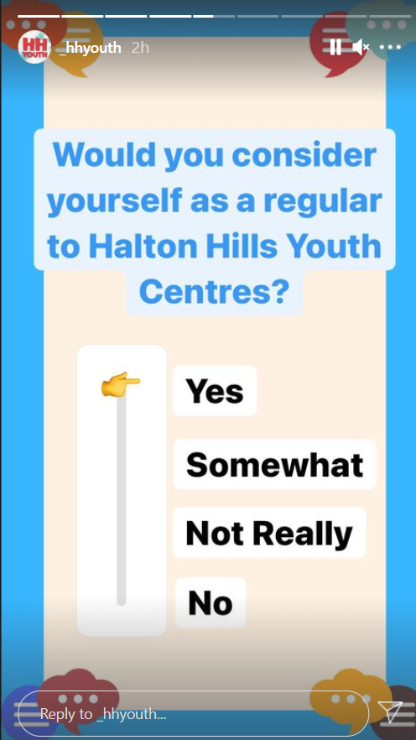
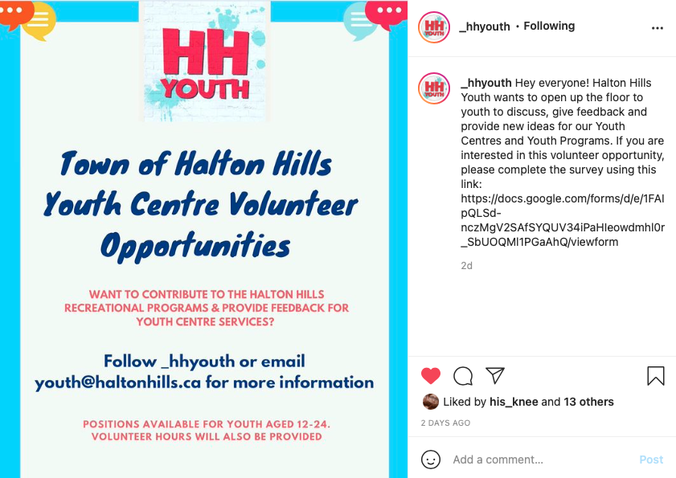
Instagram Posts and Stories
Z
We transferred the questions of the survey onto Instagram stories, and made a post with one of our posters. The questions were things like
Which Youth Center do you frequent?
Are you interested in Program X/Y?
What times are ideal for Program X/Y
What school do you attend? What Grade are you?
Notes:
Zaynab

Slide 9
Announcements at Schools
H
We made contact with schools who housed our target demographic of youth and had them make digital announcements of our program and survey, through either Google Classroom, D2L, posters, or announcements over the intercom.

Slide 10
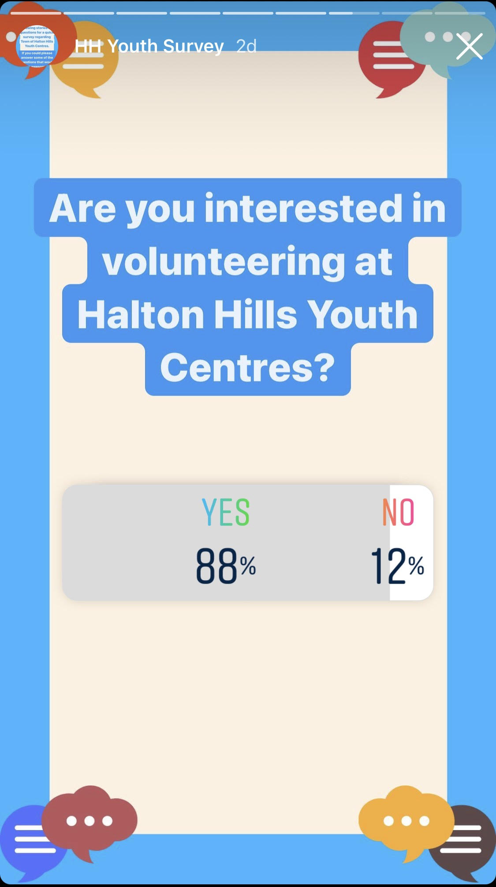
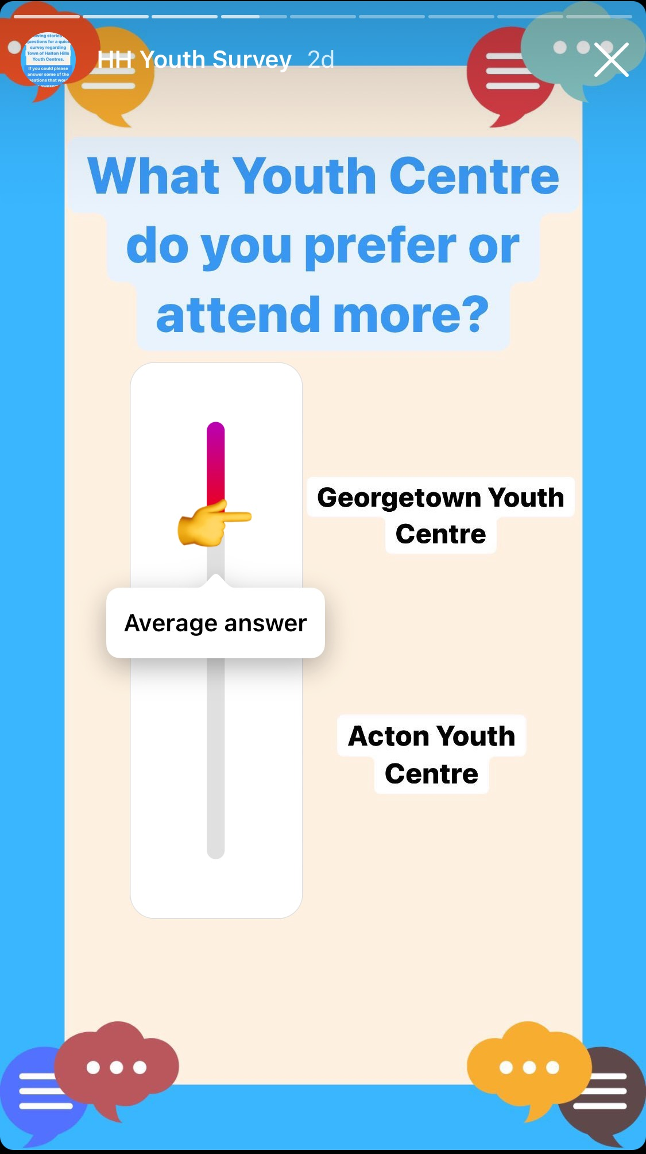
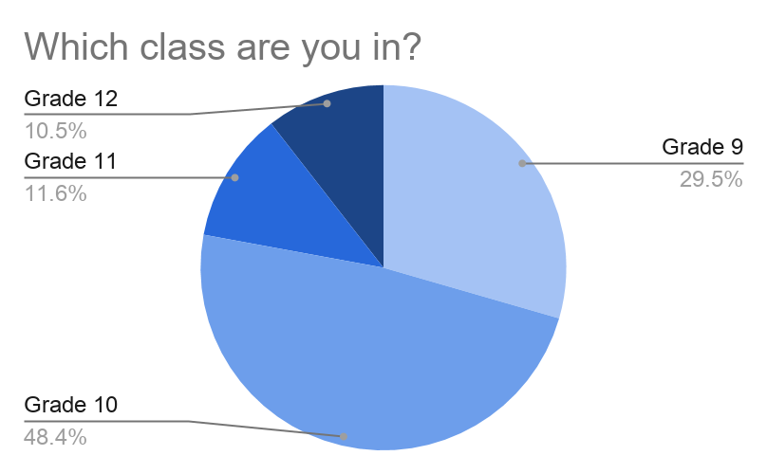
Results of the Instagram Survey
Z
Responses: 95
Notes:
Zaynab

Slide 11
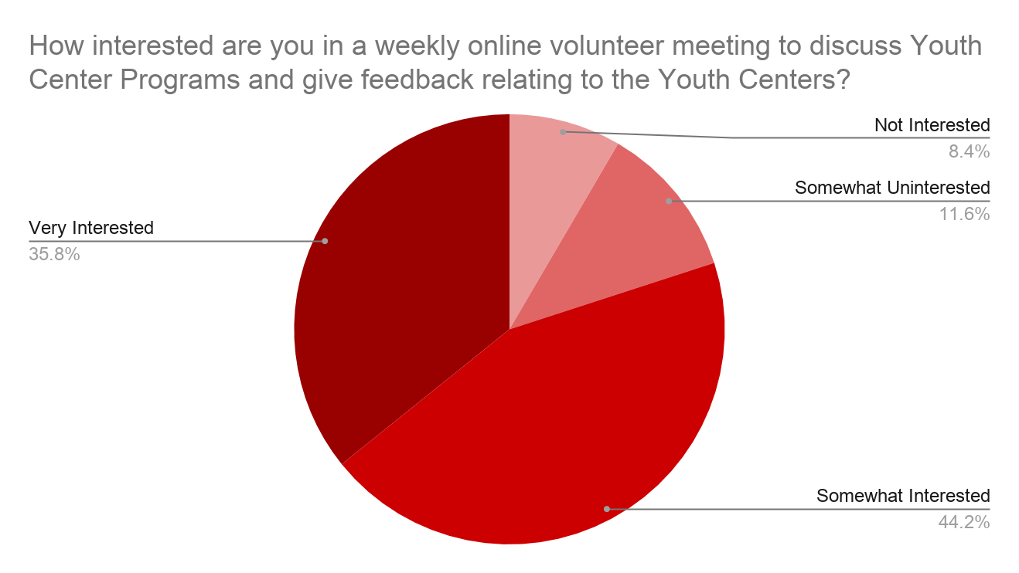
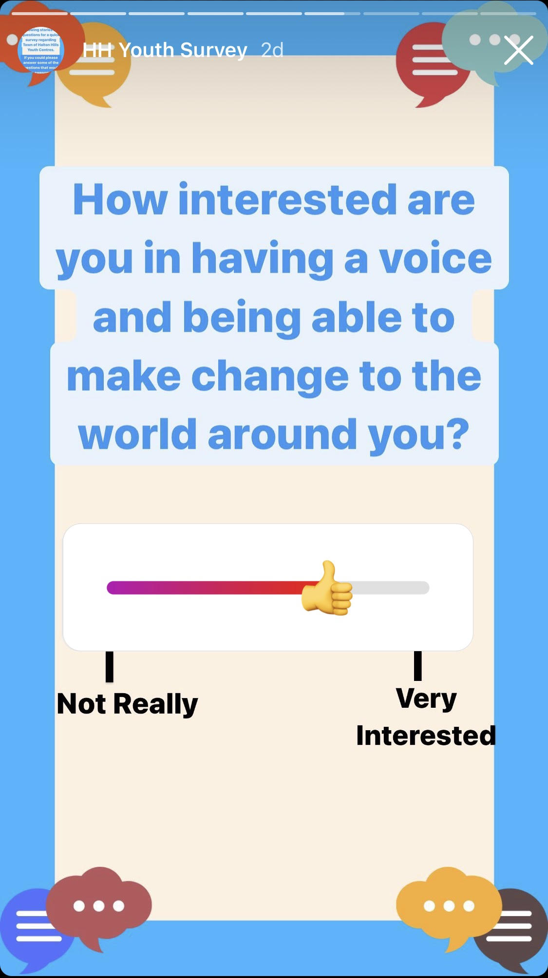
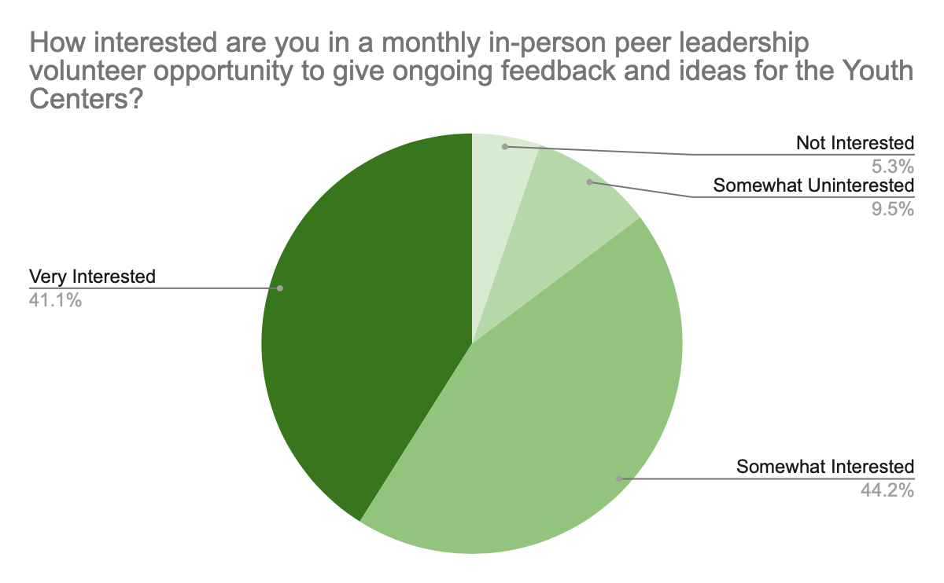
Results of the Instagram Survey
H

Slide 12
Where we are now
Next Steps
Z
Advertising has been sent out to all sources.
Program details and volunteer criteria have been finalized.
Data from social media promotional campaign has been collected.
Volunteer Sign-Up
Organizing in-person meetings with volunteer participation.
Creating and Implementing new programs and services for youth in youth centres.

Slide 13
H
Thank You for Your Time and Attention
We Hope You Enjoyed the Presentation and Our Program

