Slide 1
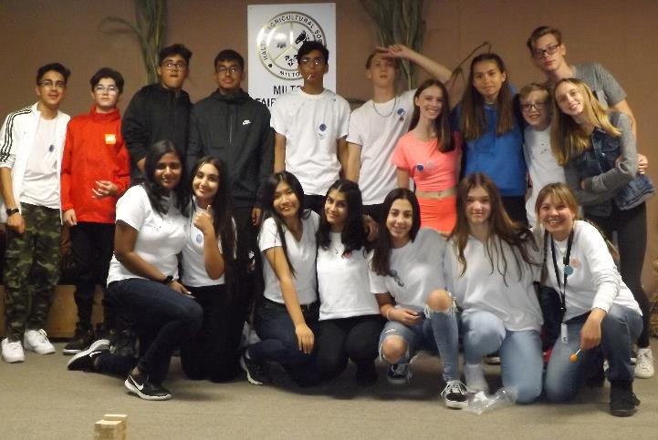
Creating youth friendly spaces at your fair

Slide 2
Introductions

Slide 3
Summary (setting the stage)
2019 Milton Fall Fair (Hosted by the Halton Agricultural Society)
Milton Youth Action Team - Newly formed youth group July 2019
First project was to develop two entertainment stages for the Fall Fair
Planning from july to September 2019
Stage one: Battle of the Bands – 7 Bands performed
Stage Two: Positive youth hangout space pop-up
Photo booth, games and seating
7 community partners with interactive and informative booths

Slide 4
How this partnership developed
Making the connection: Michelle Dittmer, coordinator of youth services at the Town of Milton connected us to Rachelle Orr from the Halton Agricultural society
Communication
Mainly email
Visit - “Site inspection” and Meeting the board

Slide 5
The role each party played
Halton Agricultural society
Provided space at the Fall Fair (Friday)
Provided a budget for the Battle of the Bands
Promoted our posters and materials
Answered our questions and provided insight
Coordinated the band stage set up and sound
Lily – Staff at Halton Youth Initiative
Facilitate communication between youth & fair
Manage budget and materials acquisition
Volunteer Management
Milton youth action team
Develop stage ideas and project management
Create posters, promotions, and communicate with bands and community partners
Put together materials
Recruit day-of volunteers
Run the stages at the Fair!!

Slide 6
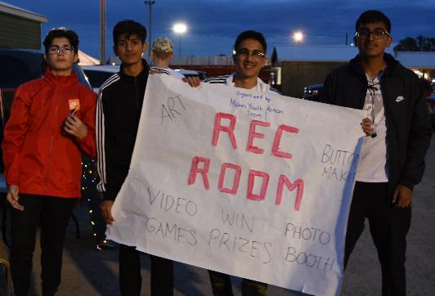
What worked & room for improvement
strengths: Great Team building, solid attendance, fun experience, solid community outreach and connections
challenges: tight timing after school on Friday, event anxiety, communicating between the two stages
Outcome: COVID-19 postponed, but we had planned on doing again

Slide 7
planning
How we came up with the entertainment ideas?
Battle of the Bands was a suggestion of the HAS
Rec Room was our idea
What was involved in making this happen?
Rec room: developing activity ideas, signing up community partners to host interactive booths, purchasing and making items needed
Battle of the bands: Creating forms, connecting with music schools, recruiting judges, creating schedule

Slide 8
Drawing youth to the fair
Promotion – Instagram, Snapchat, media outlets, at schools, with friends, community partners
Volunteers – creating a number of volunteer positions for new teens to join us at the fair
Tickets
Contest
Used budget to provide free tickets to young people in need

Slide 9
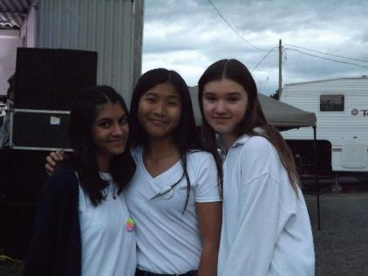
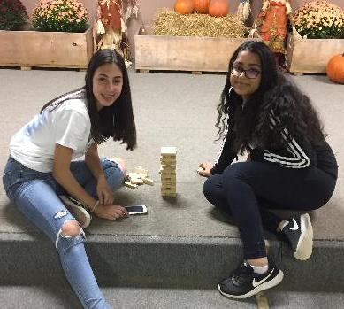
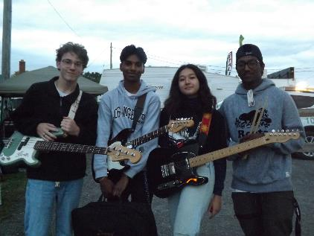
The teen experience
Volunteers
attendees

Slide 10
Q & A Period

